Slide 1
WIC Participation and Relative Quality of Household Food Purchases: Evidence from FoodAPS
NBER-FoodAPS Project: The Economic Geography of WIC
PIs: D. Fang, M.R. Thomsen, R.M. Nayga Jr., University of Arkansas
RA: Aaron Novotny, University of Arkansas
Washington, DC, Dec 7, 2017

Slide 2
Acknowledgement
This research was supported by USDA grant no. 59-5000-5-0115 to the National Bureau of Economic Research, entitled, "Using FoodAPS for Research in Diet, Health, Nutrition, and Food Security."
The views expressed are those of the authors and not necessarily those of the Economic Research Service, Food and Nutrition Service, or the U.S. Department of Agriculture

Slide 3
Introduction to The Special Supplemental Nutrition Program for Women, Infants, and Children (WIC)
Provides federal grants to states for:
1. Supplemental foods
2. Health care referrals
3. Nutritional education
State by state programs differ but requirement mainstays are categorical, residential, income, and nutritional risk eligibilities.
Food packages are tailored to category of participant.

Slide 4
WIC Eligibility
Categorical
Women who are pregnant, postpartum (up to 6 months), or breastfeeding (up to one year)
Infants up to one year old
children up to the fifth birthday
Residential
Must live in the state where benefits are received
Income
Set by the state, but no more than 185 percent of the federal poverty guideline.
Many states allow (adjunctive) participation if individuals receive SNAP, Medicaid, TANF, or other state sponsored programs.
Nutritional Need

Slide 5
Selection Bias
Nearly all studies compare participants to eligible non-participants.
Effect can be overestimated if participation is more attractive to those who are concerned about health (Gordon and Nelson 1995; Besharov and Germanis 2001).
Effect can be underestimated because participants in WIC are more likely to have characteristics associated with poor health (Bitler and Currie 2005).

Slide 6
Selection Bias and Birth Outcomes
WIC on birth outcomes is robust to selection bias (Currie and Rosin-Slater 2015). Some strategies include:
maternal fixed effects (Sonchak 2016; Currie and Rajani 2014);
instrumental variables (Gai and Feng 2012);
exploiting staggered deployment of WIC across counties early in the program history (Hoynes, Page and Stevens 2011);
comparing outcomes from mothers transitioning into and out of the program over multiple births (Figlio, Hamersma, and Roth 2009).

Slide 7
Selection Bias and Nutritional Outcomes
WIC participation is associated with improvements in dietary quality, nutrient intakes, and/or biochemical indicators of nutritional adequacy (see Fox et al. 2004; Black et al. 2012).
Because of the selection issue, it is possible to argue that those attracted into the program would have purchased the supplemental WIC foods anyway.
Some have suggested that nutrition may not be a plausible mechanism behind improved birth outcomes (Joyce, Gibson, and Coleman 2005 ).
The food packages may be an incentive to participate in the program and other program features could mitigate the likelihood of poor outcomes (Bitler and Currie 2005b).
Does WIC participation meaningfully alter food choices in a way that would be conducive to improvements in diet?

Slide 8
Why address this question?
WIC is targeted for cuts in the White House’s budget proposal (Aisch and Parlapiano 2017).
WIC foods account for 70% of program cost (Oliveira and Frazão 2015) .
FoodAPS provides unique opportunity to access WIC’s role in food choice.
In addressing this main question, we also examine whether geographic barriers limit WIC participation.

Slide 9
Using FoodAPS to Answer the Question
The focus is on dietary quality of purchases.
We focus on a subsample of WIC eligible households.
We can distinguish between WIC participating households who used WIC for purchases and those who did not.
We match both groups to eligible non participants.
We find that the improvement in nutritional quality of purchases attributed to WIC is driven entirely by those who redeemed WIC benefits.

Slide 10
Data
We use the following FoodAPS datasets:
Individual file
Household file
Event files
Geo component file
HEI datasets and programs provided by ERS.
We assembled Clinic data.
We used 2012-2013 locations if available otherwise 2015-2016 locations.
USDA-ERS personnel took our clinic data and provided radial distances from each household to the nearest WIC clinic.
We construct a Healthy Purchase Index (HPI) to measure a household’s ability to meet dietary guidelines from its food purchases.
This measure is based on the HEI-2010, but differs primarily in that
it is computed over food purchases as opposed to food intake and
it is measured at the household as opposed to the individual level.

Slide 11
Descriptive Statistics for the Household (HH) Sample
Variable | Eligible Non-Participants | WIC Participants
 |  | All | Redeemed WIC | Did Not Redeem WIC
 | N = 505 | N = 423 | N=152 | N=271
Healthy Purch. Index | 50.388 | 50.259 | 55.958 | 47.062
Rural | 0.236 | 0.234 | 0.257 | 0.221
Marital Status | 0.626 | 0.539 | 0.579 | 0.517
Hispanic | 0.247 | 0.392 | 0.351 | 0.415
African American | 0.156 | 0.172 | 0.112 | 0.205
Less High School | 0.081 | 0.163 | 0.164 | 0.162
High School | 0.196 | 0.324 | 0.309 | 0.332
Some College | 0.384 | 0.369 | 0.355 | 0.376
College or Higher | 0.339 | 0.144 | 0.171 | 0.129
Monthly Income ($1000) | 5.144 | 2.834 | 3.071 | 2.702
WIC Eligible Children | 0.853 | 0.749 | 0.822 | 0.708
WIC Eligible Infants | 0.129 | 0.286 | 0.342 | 0.255
WIC Eligible Woman | 0.158 | 0.296 | 0.283 | 0.303
WIC Clinic Access | 0.358 | 0.404 | 0.362 | 0.428
Supermarket Access | 0.145 | 0.220 | 0.191 | 0.236
Self-reported Healthy Diet | 0.382 | 0.409 | 0.375 | 0.428

Slide 12
Matching WIC Households to Eligible Non-WIC Households
Given lack of data for valid instrument, matching methods provide a way to reduce selection bias among observational data (Rosenbaum 2002; DiPrete and Gangl 2004).
The goal is to find a group of non-treated individuals who are similar to the treated individuals in all baseline characteristics.
Matching mimics a randomized experiment conditional on observed characteristics (Drichoutis, Nayga, Lazaridis 2009).
We use propensity score matching (with logistic regression to estimate the propensity score) (Rosenbaum and Rubin 1983; 1985).

Slide 13
Logit Models used to Match WIC Participants to Eligible Non-Participants
Marginal effects are for the likelihood of WIC participation. Asterisks indicate significance: *, **, and *** at the 10, 5, and 1 percent levels, respectively. All models include state fixed effects (not reported).

Slide 14
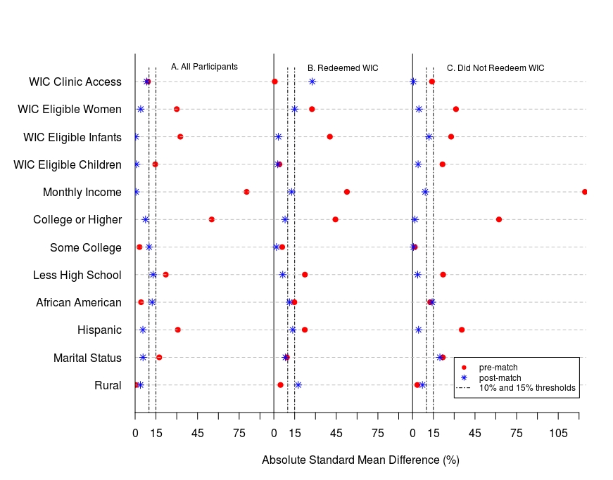
Assessing the Quality of Matched Samples

Slide 15
Average Treatment Effect on the Treated (ATT) on Healthy Purchasing Index Score from Matched WIC Subsamples.

Slide 16
Average Treatment Effect on the Treated (ATT) Estimates from Matched WIC Subsample of Households who Redeemed WIC by Component of the Healthy Purchasing Index (HPI).

Slide 17
Robustness Checks on the Importance of WIC Foods
Two potential issues:
WIC approved retailers have to stock healthier foods, which can account for some improvement in HPI.
To address the these issues:
We restricted the sample to include only households who shopped at a WIC-approved retailer during the interview period.

Slide 18
Effect of WIC Participation (Average Treatment Effect on the Treated (ATT)) on Healthy Purchasing Index Score from Matched WIC Subsamples: Excludes Households not Shopping at a WIC-approved Store.

Slide 19
Robustness Checks on the Importance of WIC Foods
Two potential issues:
A secondary selection problem may exist if shopping venues only stock partial WIC foods or if some households deem some WIC foods to be undesirable.
To address the these issues:
We re-estimated the ATT but using an HPI that excludes items from shopping events where WIC redemptions accounted for more than 50 percent of the total expenditures.

Slide 20
Effect of WIC Participation (Average Treatment Effect on the Treated (ATT)) on Healthy Purchasing Index Score from Matched WIC Subsamples: Healthy Purchasing Index Excludes Primary WIC Purchase Events.

Slide 21
Additional Findings
We explore the heterogeneity among households with and without access to supermarkets.
There is no compelling evidence that nutritional improvements from WIC are adversely affected by supermarket access.
We also explore the heterogeneity among households who reported having healthy diets and those who reported otherwise.
There is no significant difference in ATT estimates.

Slide 22
Conclusion
Households participating in WIC have higher quality of food purchase compared to eligible non-participating households.
This difference is driven entirely by households who redeemed WIC foods during the interview week.
WIC food is particularly important in improving the healthiness of total fruit, whole grains, dairy, and empty calories.
WIC foods, rather than self-selection of more nutrition-conscious households into the program, explain the improvement.
Geographic barriers do not appear to be limiting WIC participation.

